Slide 1

City of Toronto vs. New York City New restaurant Location research
Business Intelligence Report
Author: Nick Richards
Published: 8/24/2020
For informational purposes, information contained within is to display the Author’s Data Science talent, not to be used in decision making.

Slide 2
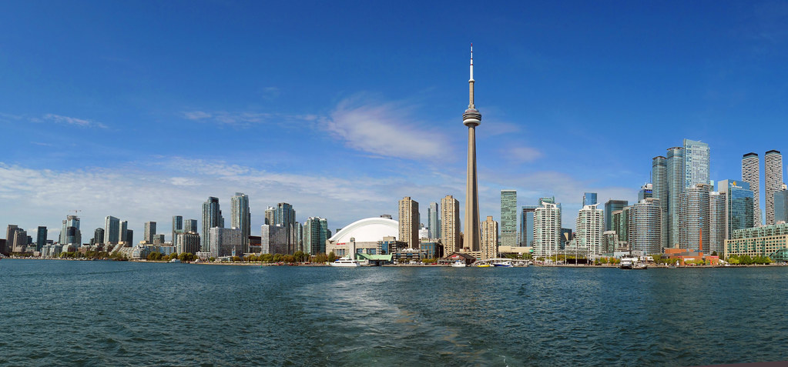
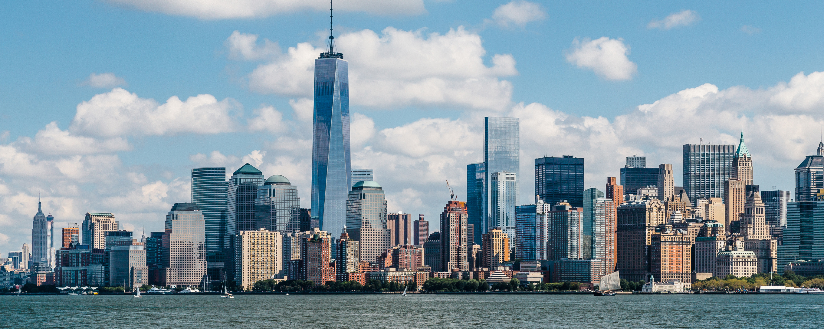
internal metrics
New York City
City of Toronto
Population estimates, 2018 | 2,956,024
High school graduate or higher | searching…
Median Household Income, 2016 | CA$ $65,829
Persons in poverty | <1%
Average price All Home Types, 2015 | CA$ $835,422
Percent of households with broadband internet subscription | searching…
Population estimates, 2019 | 8,336,817
High school graduate or higher | 81.6%
Median Household Income | US$ $60,762
Persons in poverty | 18.9%
Median Housing Value | US$ $570,500
Percent of households with broadband internet subscription | 79.4%
Source: City of Toronto url: toronto.ca
Source: Census Bureau; url: census.gov
"Toronto. A wider view." by Bernard Spragg is marked with CC0 1.0
This Photo by Unknown Author is licensed under CC BY

Slide 3
Both cities were experiencing healthy GDP growth pre-pandemic GDP: Gross domestic product (US$ in millions); CREATED IN EXCEL WORKBOOK
Source: United Nations; url: data.un.org
Source: U.S. Bureau of Economic Analysis; url: bea.gov

Slide 4
COVID-19 pandemic toll on both cities all reported cases with recorded death or Hospitalization/recovery data; created in excel workbook
City of Toronto
New York City
Source: City of Toronto; url: toronto.ca; data as of 8/20/2020
Source: New York City; url: nyc.gov; data as of 8/22/2020 1pm EST

Slide 5
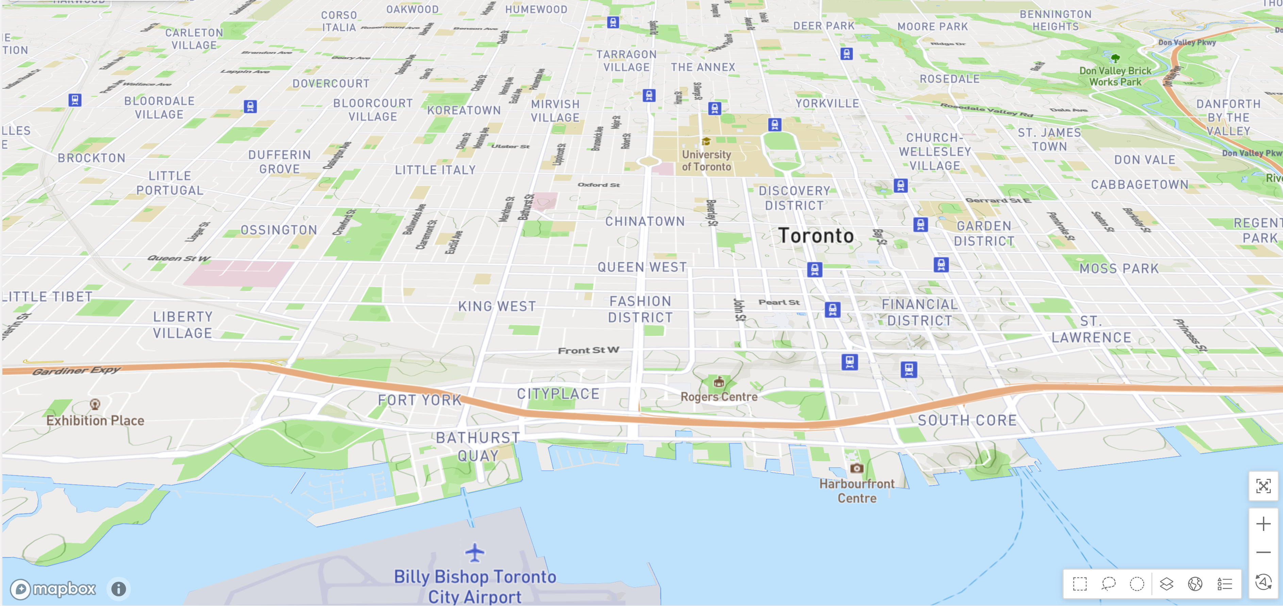
New restaurant location research for the city of Toronto
CITY OF TORONTO – VISUAL DIMENSATIONS
Source: mapbox.com; created using MicroStrategy Desktop

Slide 6
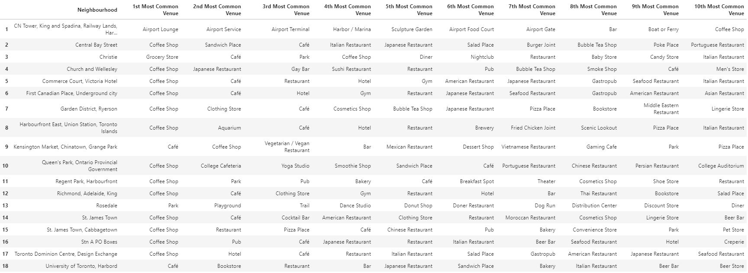
Top 10 Most common venues around Downtown Toronto Single API Data Source: foursquare.com User engagement metrics; created using python notebook
CITY OF TORONTO – NEIGHBORHOODS IN DOWNTOWN TORONTO DISTRICT

Slide 7
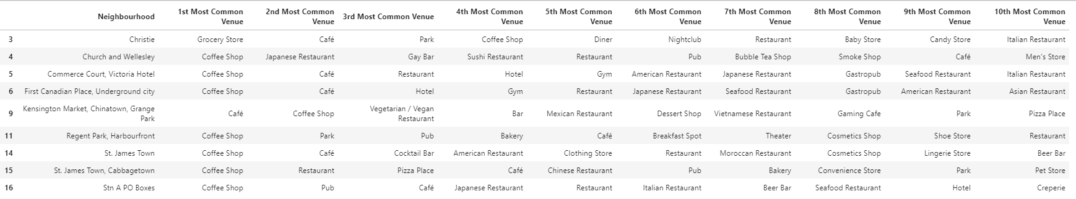
Top 10 DOWNTOWN TORONTO NEIBOURHOODS with the most food-related foot traffic Single API Data Source: foursquare.com User engagement metrics; created using python notebook
10 of the Top 10 most common venues are food-related
Other Downtown Toronto Neibourhoods where most of the Top 10 most common venues are food-related

Slide 8
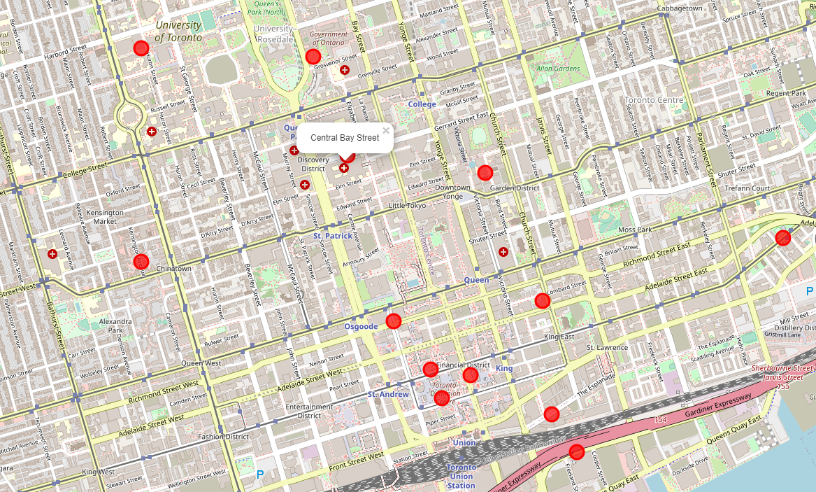

Central bay street, city of Toronto – visual Dimensions Source: leafletjs.com; created using folium in python notebook
Surrounding Neighborhoods

Slide 9
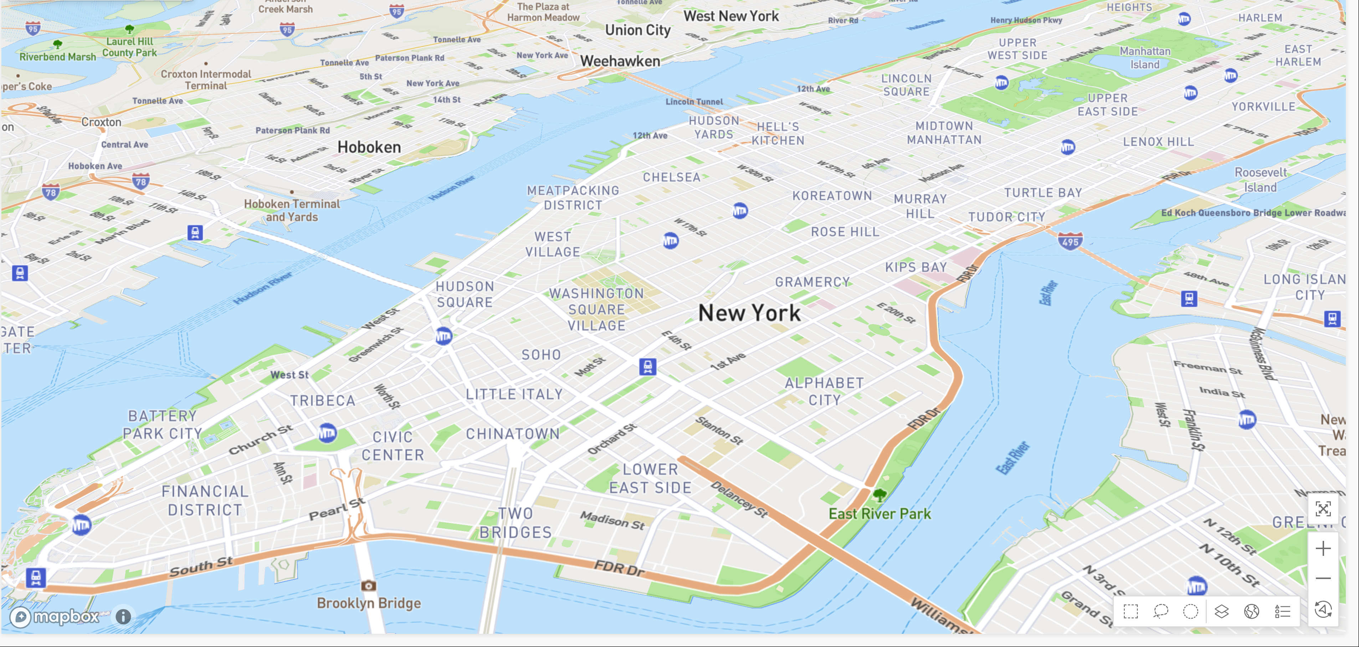
New restaurant location research for new York city
NEW YORK CITY - VISUAL DIMENSIONS
Source: mapbox.com; created using MicroStrategy Desktop

Slide 10
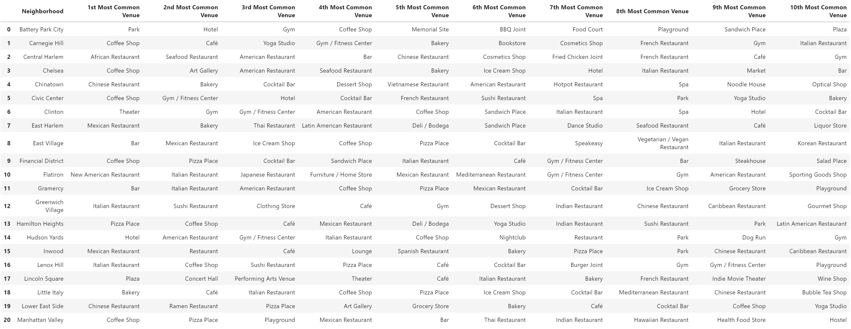
Top 10 Most common venues around Manhattan Single API Data Source: foursquare.com User engagement metrics; created using python notebook
NEW YORK CITY – NEIGHBORHOODS IN THE MANHATTAN BOROUGH

Slide 11
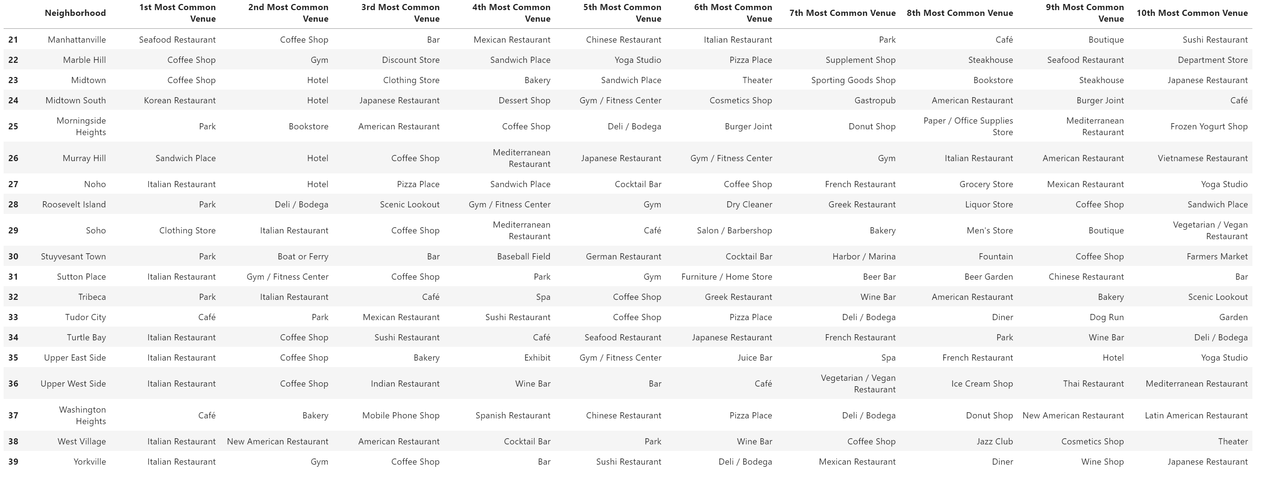
Top 10 Most common venues around Manhattan Single API Data Source: foursquare.com User engagement metrics; created using python notebook
NEW YORK CITY – NEIGHBORHOODS IN THE MANHATTAN BOROUGH

Slide 12
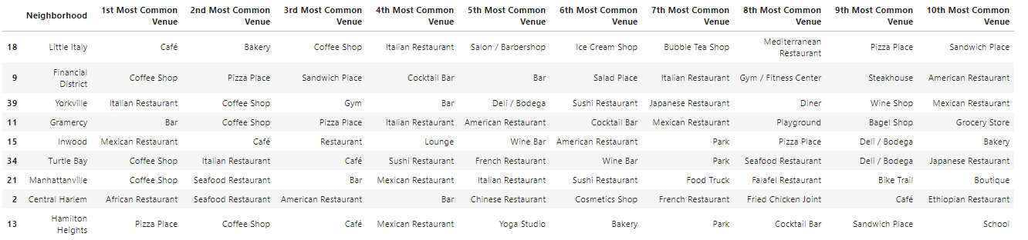
Top 10 Manhattan borough neighborhoods with the most food-related foot traffic Single API Data Source: foursquare.com User engagement metrics; created in python notebook
10 of the Top 10 most common venues are food-related
Other Manhattan Borough Neighborhoods where most of the Top 10 most common venues are food-related

Slide 13
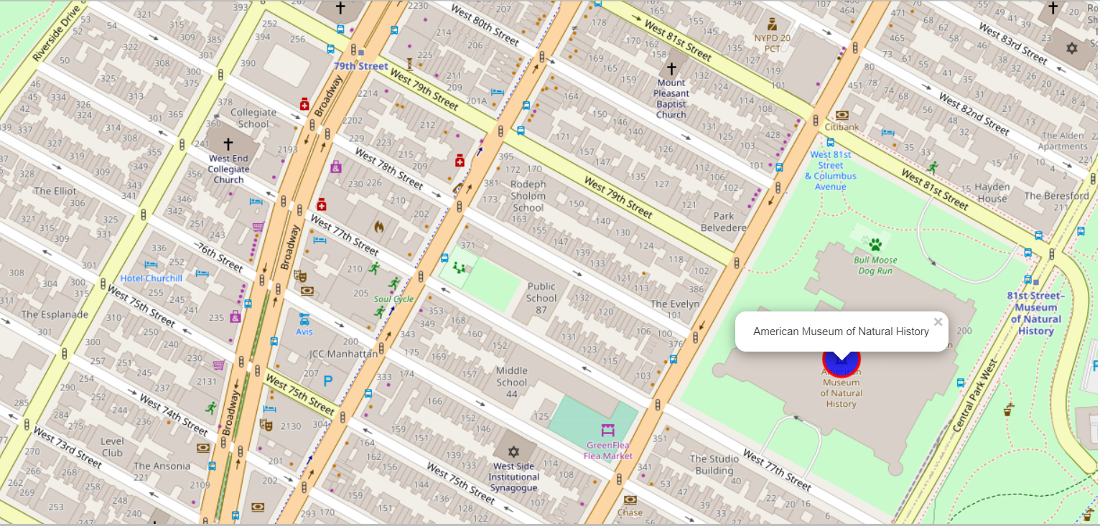
Upper west side, NYC – visual Dimensions Source: leafletjs.com; created using folium in python notebook
AMERICAN MUSEUM OF NATURAL HISTORY

Slide 14
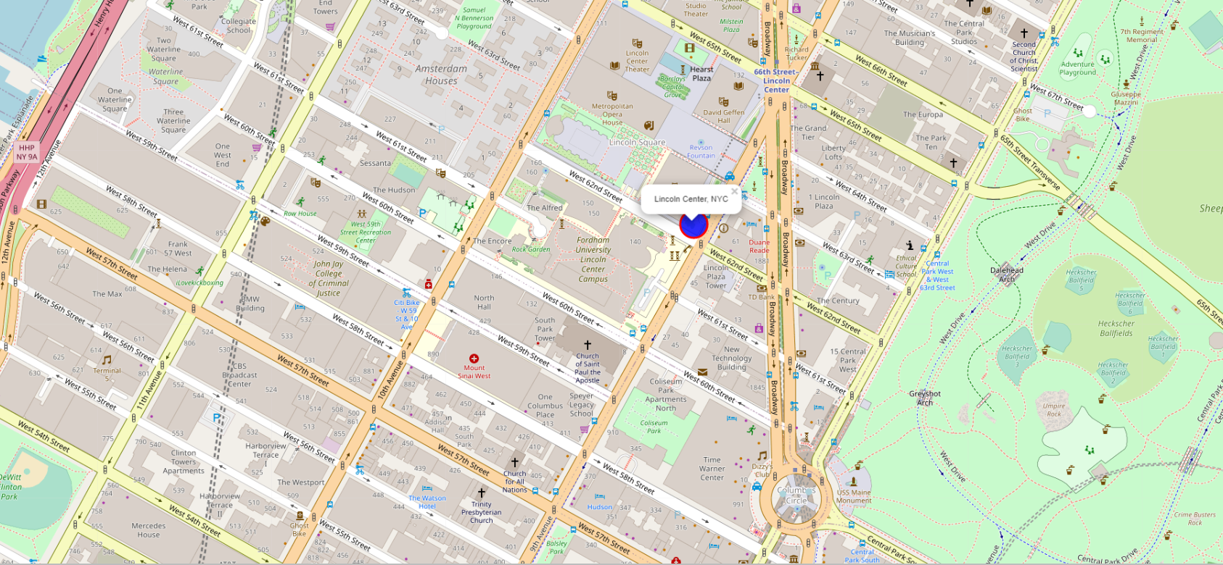
Upper west side, NYC – visual Dimensions Source: leafletjs.com; created using folium in python notebook
LINCOLN CENTER, NYC

Slide 15
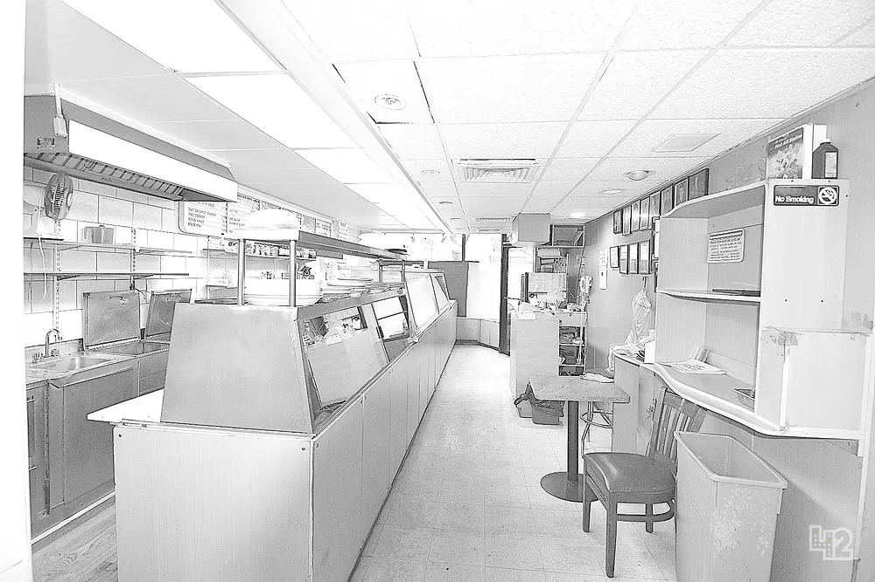
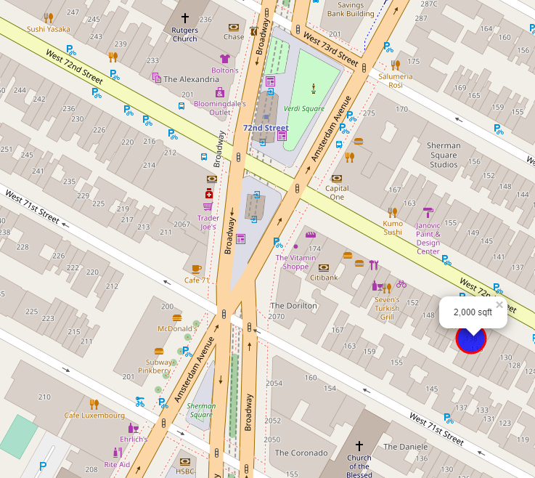
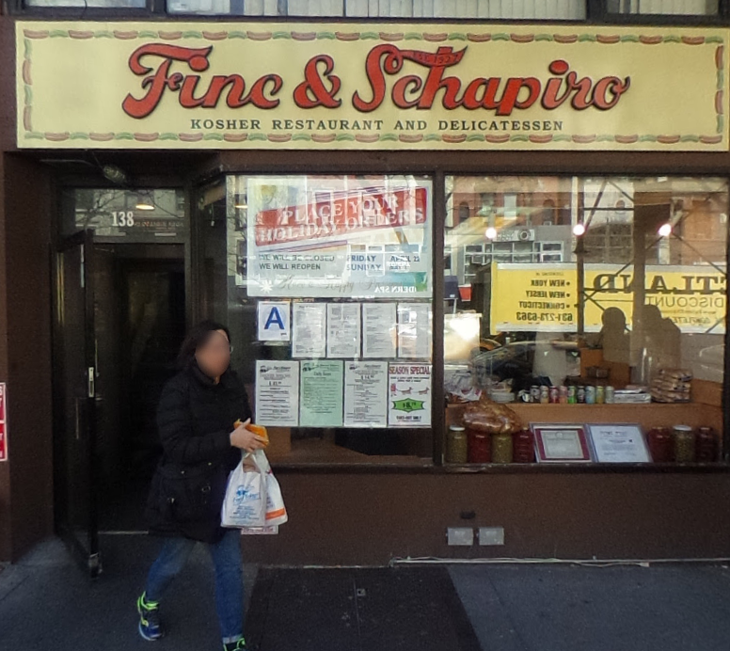
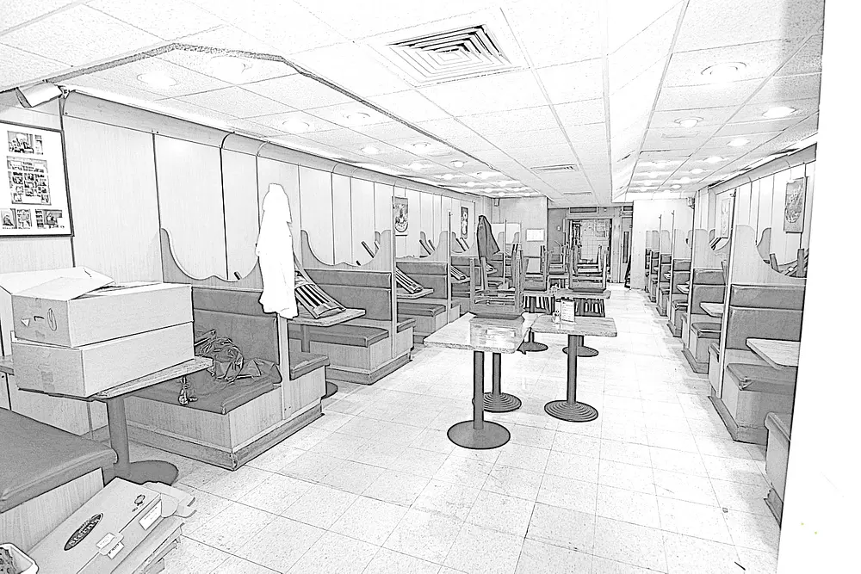
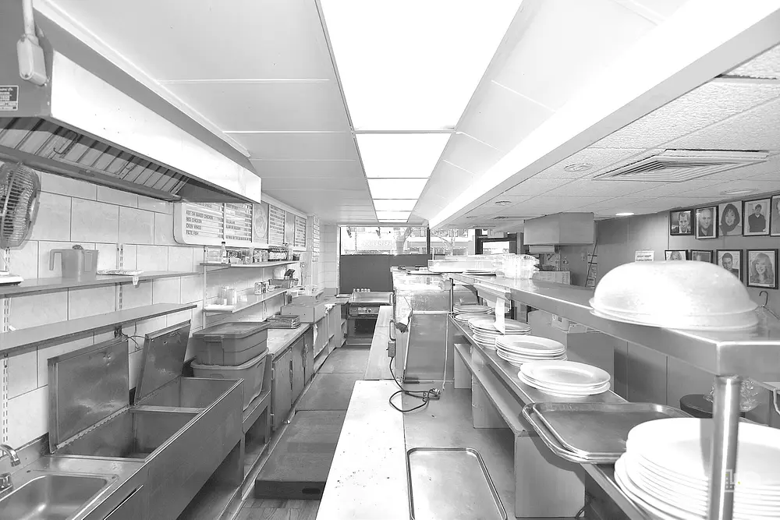
Available Location for lease – Upper west side, nyc map Source: leafletjs.com; created using folium in python notebook
138 W 72ND ST RESTAURANT FOR RENT (FORMER FIRE & SCHAPIRO LOCATION) - $13,500/mo.
Pictures of location featured
Google Street View
Listing Data Source: https://42floors.com/us/ny/manhattan/138-w-72nd-st?listings=1787496

